Slide 1
A preliminary typology of teachers with multiple jobs based on professional life stories
Lianne Teder
Rain Mikser
14.08.2019
EARLI 2019

Slide 2
terminology
Moonlighting (Guthrie, 1969)
Multiple jobs (Averett, 2001)
Slash career (Alboher, 2012)
School year
Summer vacation
Notes:
Teachers who additionally employed out of school and those who are self-employed.
Outside job, multiple job holdins, multiple employment

Slide 3
Spread of phenomena

Slide 4
Reasons for moonlighting
Professions in Estonia:
53% education
18% arts, entertainment and spare time
37% high-level specialists
15% managers
15% specialists
13% officials
Low salary and financial issues
Wish to develop certain interests
Preparation for leaving profession
Inner need for self-development

Slide 5
methodology
THE AIM:
To understand the meaning and importance that teacher place on jobs that they have held in addition to their full-time teaching job.
Life history methodology: Work-life narratives focused on professional life histories, applying interviews as data collection method (Goodson, 2010)
8 teachers interviewed (3 of them twice) out of 52, who had teaching experience more than 21 years, and have hold the supplementary jobs during the career

Slide 6
Analysis
Thematic analysis, combined deductive and inductive approaches (Braun & Clarke, 2006)
Predetermined three themes (McAlpine, 2016)

Slide 7
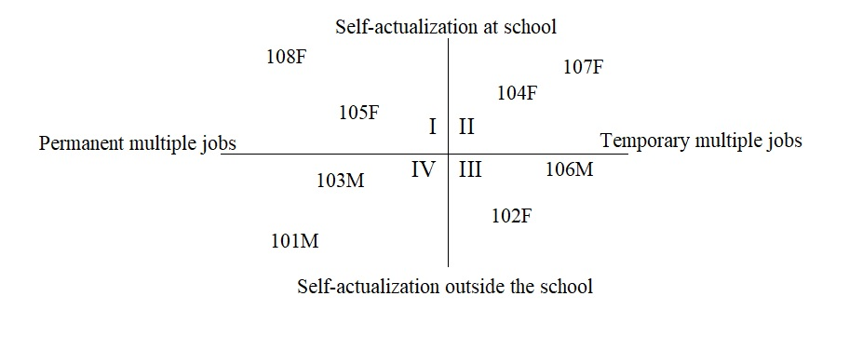
results: Four clusters
Type II: Higher self-confidence, and role-models for student
Types I and IV: Strongest connection between the school environment and everyday life.
Type III teachers transferred their experiences to the school most often, adapting and designing the learning environment by following out-of-school models.

Slide 8


Thank you!
Lianne Teder
lianne@tlu.ee

